Slide 1

Global Air Pollution
By Karnik Aswani

Slide 2

What is Air Pollution?
Any activity or substance that cause contamination either the indoor or outdoor environment.
This would include chemical, physical, or biological processes affecting the earth atmosphere.

Slide 3
Types of Pollutants
Nitrogen Dioxide (NO2)
  Formed by cars, trucks and buses emissions, power plants and off-road equipment which exhaust gasses.
  Breathing NO2 can cause severe symptoms such as asthma and respiratory infections.
Ozone (O3)
  A molecule composed of three oxygen atoms bonded together.
  It can cause respiratory irritation and lung damage.
Particulate Matter
  Tiny particles in the air that are 2.5 smaller in diameter.
  It can cause coughing, shortness of breath, increased risk of infections, heart attacks, and other potential symptoms.
Carbon Dioxide (CO2)
  Component of carbon cycle and produce various natural processes such as respiration and decay of organic matter.
  Excess levels of CO2 can produce hypercapnia, CO2 levels in the bloodstream is too high.

Slide 4
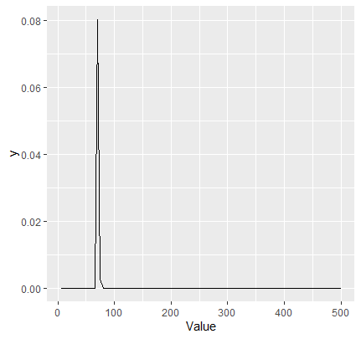
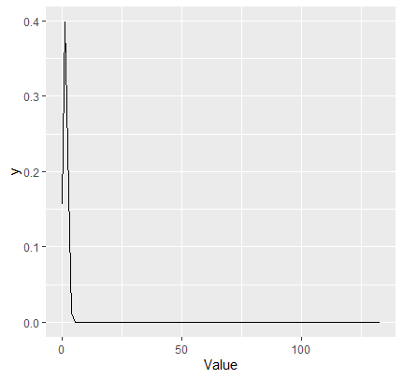

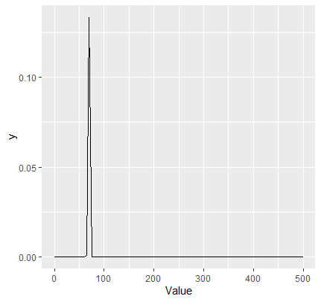
Distribution Plots for Each Variable
AQI Value
CO2 AQI Value
Ozone AQI Value
NO2 AQI Value
PM2.5 AQI Value

Slide 5
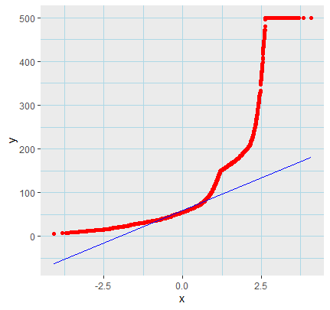
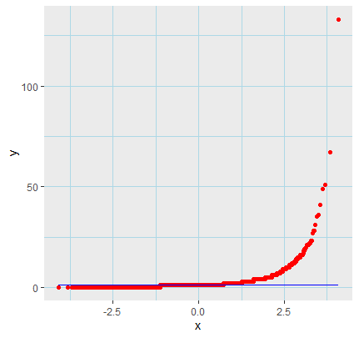
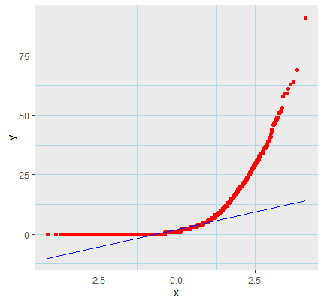
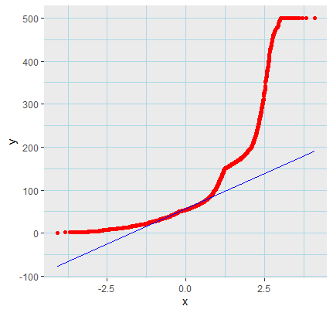
QQ Plots
AQI Value
CO2 AQI Value
NO2 AQI Value
PM2.5 AQI Value

Slide 6
One Sample T - Test
  The p-values for all variables (AQI, CO AQI, NO2 AQI, O3 AQI, and PM2.5 AQI) are almost zero (< 2.2e-16), which means we reject the idea that their average values are 130. In other words, these air quality measures are quite different from what we expected.
  In simple terms, all the air quality measures were significantly different from the expected value of 130. It's like expecting everyone to score 130 on a test, but the actual scores were very different, just like comparing apples to oranges. This indicates substantial variations in air quality.

Slide 7
Two Sample T-test
This test checks if two sets of values have very different averages. For AQI and CO AQI, the p-value is almost zero (< 2.2e-16), meaning their averages are significantly different.

Slide 8
Chow Test
When comparing AQI to CO AQI and AQI to NO2 AQI:
  There are no big changes or structural breaks in how these air quality measures relate to each other.
  It's like saying these relationships are consistent and stable over time.
However, when comparing AQI to PM2.5 AQI:
  There might be a significant change or structural break in how AQI and PM2.5 AQI are related.
  This suggests that something might have caused a shift in this relationship. More investigation is needed to confirm this.
The p-values in the results help us decide how certain we are about these conclusions. Lower p-values mean we're more confident in our findings.

Slide 9
Chi-Square Test
The location or city where the air quality data was collected might not be a significant factor in determining the levels of air pollutants. The data does not provide strong evidence that cities have a major impact on air quality differences.

Slide 10
XGBoost Model Results
AQI Value:
  The model demonstrates relatively good predictive performance for the given data.
CO2 AQ Value
  This XGBoost model performs very well regarding predictive accuracy for the given data.
Ozone AQI Value
  This XGBoost model performs very well regarding predictive accuracy for the given data.
NO2 AQI Value
  This XGBoost model performs very well regarding predictive accuracy for the given data.
PM2.5 AQI Value
  This XGBoost model performs very well regarding predictive accuracy for the given data.

Slide 11
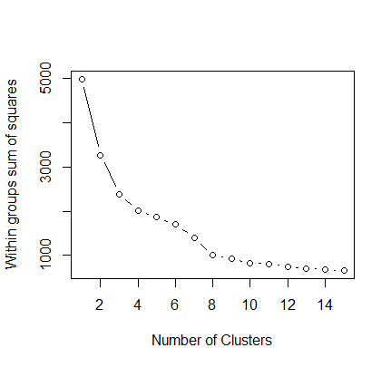
K – Means Cluster Analysis
Conclusion: the K-Means cluster analysis resulted in eight clusters, but the lack of a pronounced elbow in the WSS plot made it difficult to determine the optimal number of clusters.

Slide 12
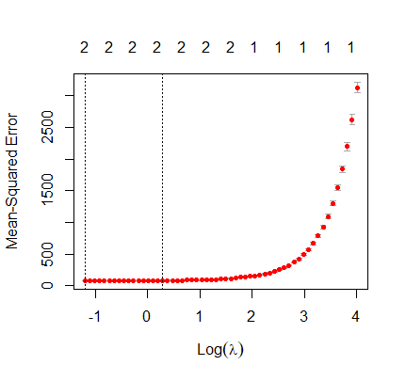
Lasso Regression
Conclusion: The high R-squared value of 0.960 indicates that the model is a good fit for the data, as it explains a significant proportion of the total variation in the dependent variable. In practical terms, this means that the predictors used in the model have strong explanatory power and can account for a large portion of the variation observed in the dependent variable. The model appears to be effective in capturing the underlying patterns in the data and making accurate predictions.

Slide 13
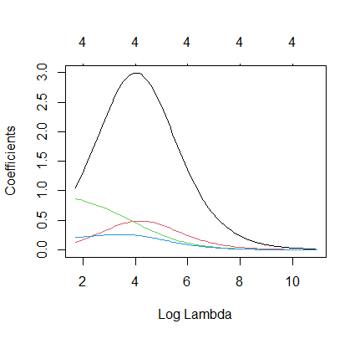
Ridge Regression
Conclusion: The high R-squared value of 0.966 indicates that the model is a good fit for the data, as it explains a significant proportion of the total variation in the dependent variable. In practical terms, this means that the predictors used in the model have strong explanatory power and can account for a large portion of the variation observed in the dependent variable. The model appears to be effective in capturing the underlying patterns in the data and making accurate predictions.

Slide 14
Conclusion
In our analysis of air quality data, we used different statistical methods and data visualization to understand air quality patterns. We noticed that air quality changes over time, possibly due to seasonal variations. When we looked at specific air quality measures like NO2, PM2.5, and Ozone, we found they have their unique trends. We also built a machine learning model to predict the Air Quality Index (AQI) effectively. Using k-means clustering, we grouped data into clusters with different air quality characteristics. Lastly, we used t-tests to show that AQI is significantly different from individual air quality parameters. These results provide a comprehensive view of air quality trends and can help environmental monitoring and management efforts.

Slide 15
Recommendations
Seasonal Monitoring: Given the observed seasonal variations in air quality, it's essential to maintain continuous monitoring throughout the year. This will help identify and mitigate air quality issues more effectively during specific seasons.
Pollutant-Specific Strategies: Develop pollution control strategies tailored to specific air pollutants. For example, focusing on reducing NO2 or Ozone levels might require different approaches due to their distinct trends and characteristics.
Machine Learning for Prediction: Utilize machine learning models like XGBoost for AQI prediction. Such models can provide accurate forecasts, which are valuable for public awareness and health advisories.
Cluster-Based Analysis: Grouping air quality data into clusters using k-means can aid in zoning for pollution control. Tailor air quality improvement efforts to specific areas with similar air quality characteristics.
Continuous Improvement: Regularly update and fine-tune models and strategies based on new data. Air quality is subject to change, and staying up-to-date is crucial for effective management.

Slide 16
Recommendations continue…
Policy and Regulation: Use statistical tests like t-tests to highlight differences between AQI and individual air quality parameters. This information can inform policy decisions and regulatory actions to address specific pollutants.
Community Awareness: Share air quality information and findings with the local community. Public awareness is essential for taking precautions during poor air quality periods and for garnering support for pollution control measures.
Collaboration: Collaborate with environmental agencies, research institutions, and local authorities to enhance air quality monitoring and research efforts. Pooling resources and expertise can lead to more effective strategies.
Emergency Response Plan: Develop an emergency response plan for severe air quality events. This plan should outline actions to be taken when air quality deteriorates rapidly, with a focus on protecting public health.
Long-term Sustainability: Consider sustainable and eco-friendly measures for air quality improvement. This could include promoting cleaner transportation options, renewable energy sources, and green infrastructure.

Slide 17
References
https://datagy.io/python-correlation-matrix/
https://datascientyst.com/pandas-cheat-sheet-data-cleaning/
https://www.statology.org/label-encoding-in-python/
https://www.statology.org/pandas-train-test/
https://www.statology.org/data-cleaning-in-r/
https://www.statology.org/plot-normal-distribution-r/
https://www.statology.org/chi-square-test-of-independence-in-r/
https://www.statmethods.net/advstats/cluster.html
https://www.statology.org/chow-test-in-r/
https://www.statology.org/chi-square-test-of-independence-in-r/
https://www.statology.org/one-sample-t-test-in-r/
https://www.statology.org/two-sample-t-test-in-r/
https://www.statology.org/ridge-regression-in-r/
https://www.statology.org/lasso-regression-in-r/
https://www.statology.org/xgboost-in-r/

